Slide 1


SHIFT CONSULTANCY
2D SLAM-based Childcare Robot
WWW.NANNYBOT.COM.AU

Slide 2


OUR TEAM
Mary
Yazbek
Director of Operations
Patrick Weinstein
Project Manager
Meghna Meghna
Project Manager
John
Machado
Project Manager

Slide 3





Introduction
Falls are a leading cause of injury among children, prompting thousands of emergency visits daily in the U.S. due to accidents involving stairs and windows.
This issue highlights the need for enhanced supervision in environments like kindergartens, where constant vigilance is challenging.
Our project proposes using 2D SLAM robots equipped with LiDAR sensors for real-time navigation and monitoring within indoor settings such as schools and childcare centers.

Slide 4


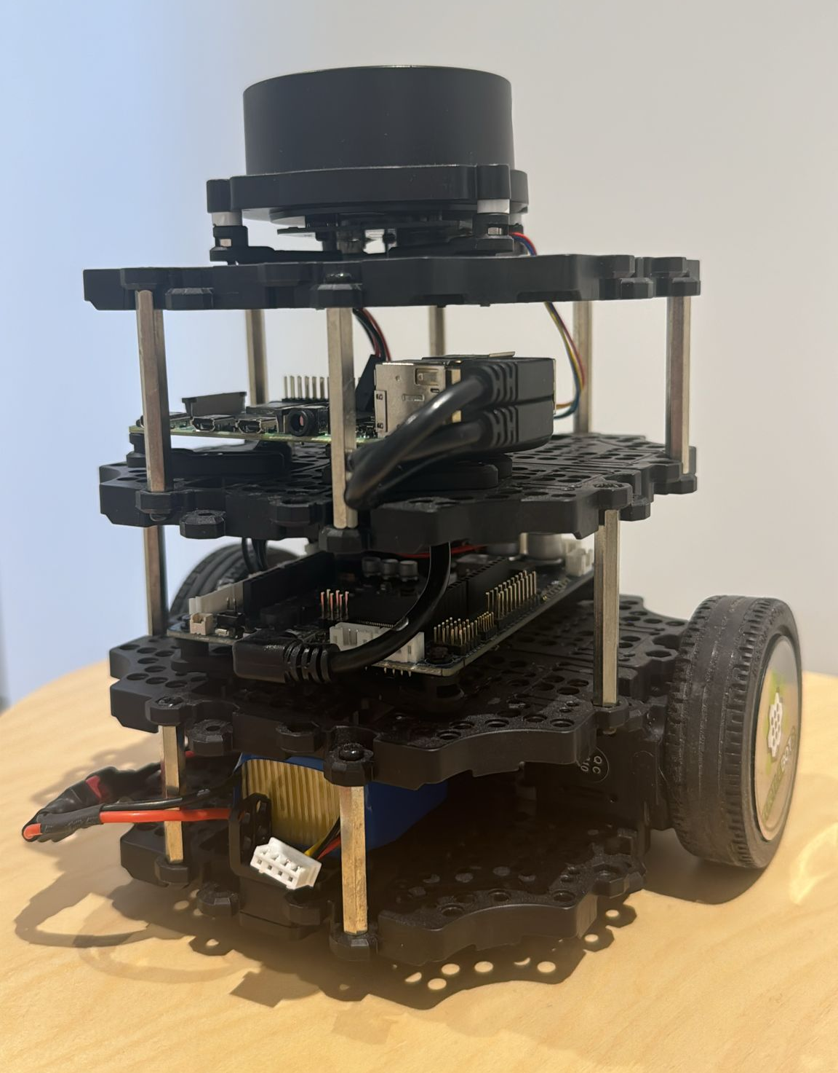
Project Objectives
Develop an Autonomous Navigation System
Integrate Real-Time Obstacle Detection and Avoidance
Optimize Hardware and Software Performance
Test and Validate System in Real-World Scenario

Slide 5
THANK YOU!
ANY QUESTIONS?

